Slide 1
SI 618: Data Manipulation and Analysis Advanced Data Collection Topics
Instructor: Ceren Budak
GSIs: Hareesh Karthik and Mengyan Wu

Slide 2
We've covered methods for fetching, manipulating and extracting information from different data types:
Unstructured data: text (in various encodings)
Semi-structured data: tagged content (HTML, JSON)
Structured data: SQL
Fetching data using Web APIs
What are some other topics in large-scale data gathering that you should know about?
Topics covered in upcoming weeks
Large-scale processing with Hadoop
Tasks that combine all of the above
Parallel processing (Spark), text regex, parsing tagged data

Slide 3
Big data: Which technologies will be critical for data gathering, manipulation, analysis?
A/B testing, experimental data gathering
Crowdsourcing
Network analysis
Data fusion and integration
Machine learning: classification
Natural language processing
Signal processing
Simulation
Time series analysis
Visualization
Source: http://www.mckinsey.com/insights/business_technology/big_data_the_next_frontier_for_innovation

Slide 4
Two new sources of large volumes of data processing:
A/B testing, experimental data (web site optimization)
Crowdsourcing and human computation
Network analysis
Data fusion and integration
Genetic algorithms
Machine learning
Natural language processing
Signal processing
Simulation
Time series analysis
Visualization

Slide 5
Two new sources of large volumes of data processing:
A/B testing, experimental data (web site optimization)
Crowdsourcing and human computation
Network analysis
Data fusion and integration
Genetic algorithms
Machine learning
Natural language processing
Signal processing
Simulation
Time series analysis
Visualization

Slide 6
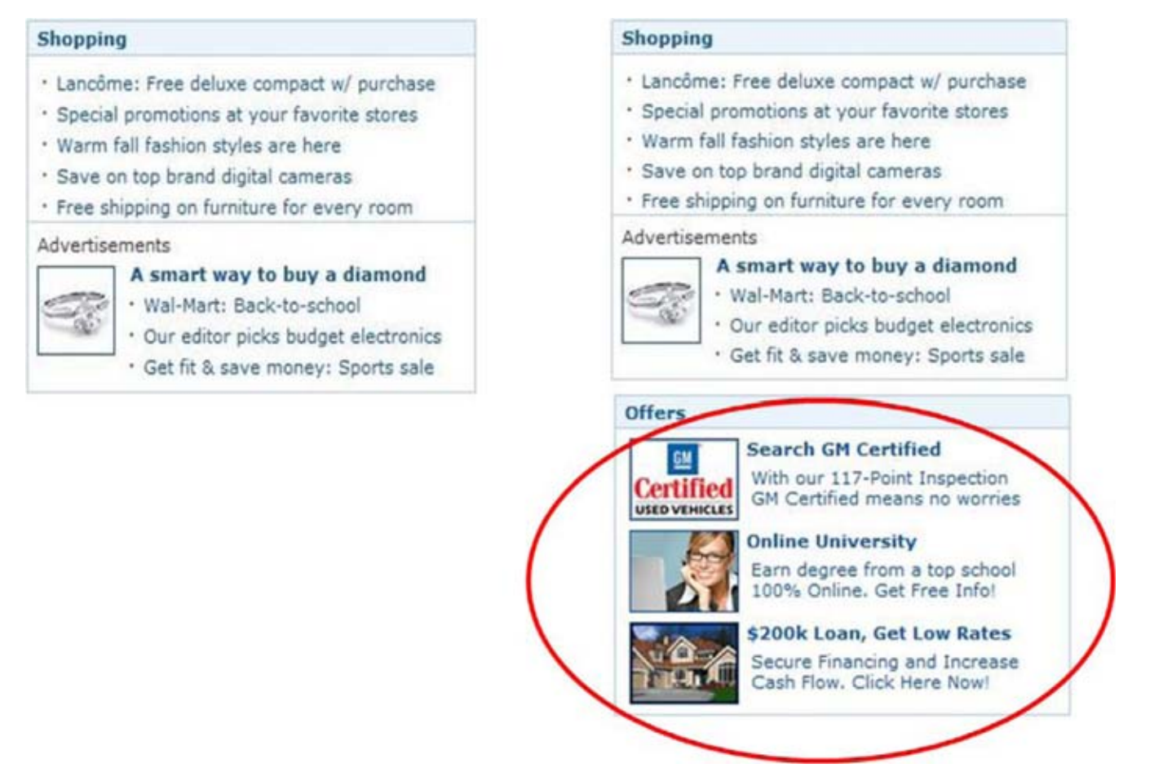
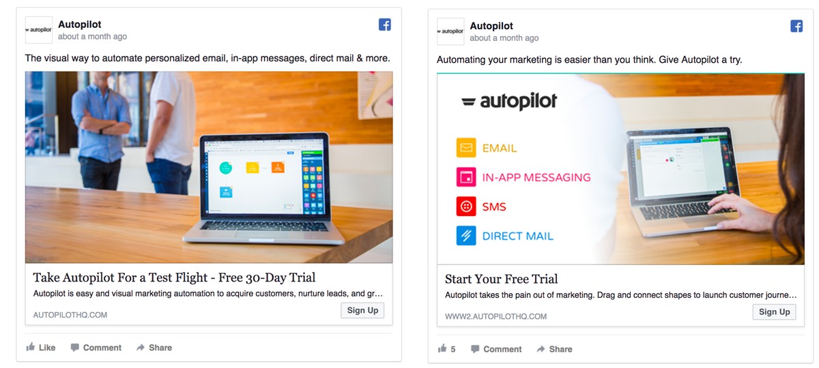
The cost of showing ads
A
B
A
B

Slide 7

How to recommend?
A: Users who bought item j also bought…
B: Users who viewed item j also viewed…

Slide 8
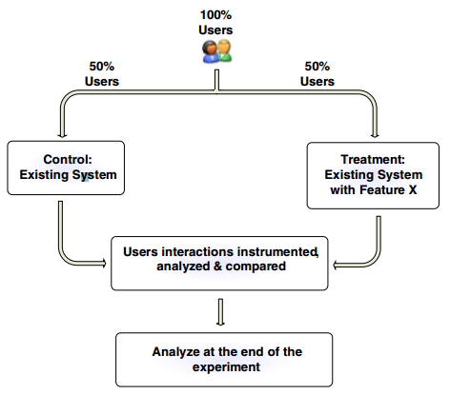
The basic A/B experiment: a form of controlled trial
Overall Evaluation Criterion (OEC) Evaluation/performance measure
Scorecard: multi-metrics
Good metric properties:
Predict long-term goals (repeats over time)
Single measure (perhaps weighted combo)
Decided and fixed in advance!
Source: http://ai.stanford.edu/~ronnyk/2009controlledExperimentsOnTheWebSurvey.pdf

Slide 9
An important special case: the A/A test
Sometimes called a Null test.
Split users as with A/B…
But expose them to the same control experience A
What possible reason could there be for doing this?
Reasons include:
Exercise experimentation system to find bugs/bottlenecks.
Assess the variability of the performance metric for statistical power analysis.

Slide 10
How to test for effect size?
Important factors:
Confidence level: generally set to 95%. This means that 5% of the time we will incorrectly conclude there is a difference when there is none. (Type 1 error)
Power: The probability of correctly rejecting the null hypothesis (i.e. there is no difference) when it is false. Usually around 80-95%.
Standard error: The smaller the standard error, the more power. How to reduce:
Larger samples
Use measures that have inherently low variability
Effect: The difference in the measure between groups (the mean of treatment – the mean of control)

Slide 11
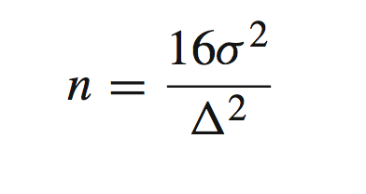
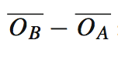
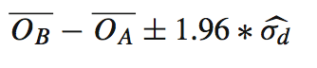
How to test for effect size
Apply a t-test to see if difference in means is significant
How to identify the minimum sample size? Assuming the desired confidence interval is 95% an power is 80% is where n is the number of users (units) in each variant , sigma^2 is the variance and delta is the sensitivity
Effect size:
Confidence intervals of effect size:
An e-commerce site with 5% of users who visit end up purchasing. Those purchasing spend ~$75 (average user spends $3.75). Assume the standard deviation is $30. If you are running an A/B test and want to detect a 5% change to revenue, you will need: 16 ∗ 30^2/(3.75 ∗ 0.05)^2 users.

Slide 12
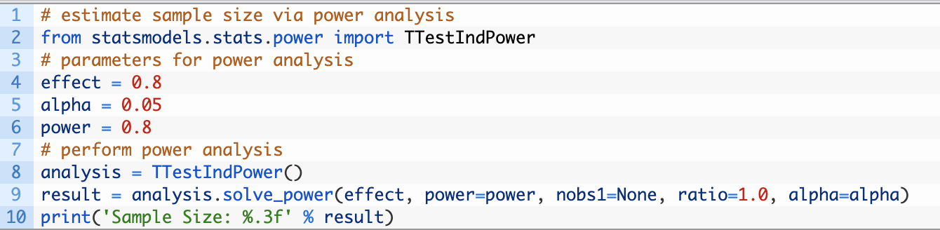
How to test for effect size
Apply a t-test to see if difference in means is significant
How do you do this with python?
the ratio of the number of samples in one sample to the other.

Slide 13
The importance of data analysis for experimental data
Scenario: An A/B experiment was run to test a new shopping feature.
Outcome: Over all users, no statistically significant differences in user satisfaction for the feature were observed between A and B.
We're done, right? The feature clearly doesn't help.
Wrong! We need to look at specific user segments:
A segment of users with a certain browser version never preferred B: because of a browser bug!
Fixing the bug led to positive outcome for the feature!
Source: http://ai.stanford.edu/~ronnyk/2009controlledExperimentsOnTheWebSurvey.pdf

Slide 14
Why deeper data analysis is critical…
UserID | Shown | Browser | Outcome
342F34AB | A | IE 8.0 | 0
437346EF | A | Chrome 13.2 | 0
375402AD | B | IE 9.0 | 0
003424AA | A | IE 8.0 | 1
995447FE | B | Chrome 13.2 | 1
345757BF | B | Firefox 4.5 | 1
887786EA | B | IE 9.0 | 0
100106AF | A | IE 9.0 | 1
994317AA | A | IE 9.0 | 0
097655BC | B | IE 9.0 | 0
Shown A: 5 Shown B: 5
Average outcome A: 2/5 = 0.40
Average outcome B: 2/5 = 0.40

Slide 15
Bug: IE 9.0 crashes for treatment B
UserID | Shown | Browser | Outcome
342F34AB | A | IE 8.0 | 0
437346EF | A | Chrome 13.2 | 0
375402AD | B | IE 9.0 | 0
003424AA | A | IE 8.0 | 1
995447FE | B | Chrome 13.2 | 1
345757BF | B | Firefox 4.5 | 1
887786EA | B | IE 9.0 | 0
100106AF | A | IE 9.0 | 1
994317AA | A | IE 9.0 | 0
097655BC | B | IE 9.0 | 0
P(Success | IE8) = 0.5
P(Success | Chrome) = 0.5
P(Success | Firefox) = 1.0
P(Success | IE 9.0) = 0.2
P(Success | IE 9.0 & B) = 0
A clue something may be very wrong

Slide 16
Fixing the bug reveals the true power of treatment B
UserID | Shown | Browser | Outcome
342F34AB | A | IE 8.0 | 0
437346EF | A | Chrome 13.2 | 0
375402AD | B | IE 9.0 | 1
003424AA | A | IE 8.0 | 1
995447FE | B | Chrome 13.2 | 1
345757BF | B | Firefox 4.5 | 1
887786EA | B | IE 9.0 | 0
100106AF | A | IE 9.0 | 1
994317AA | A | IE 9.0 | 0
097655BC | B | IE 9.0 | 1
P(Success | IE8) = 0.5
P(Success | Chrome) = 0.5
P(Success | Firefox) = 1.0
P(Success | IE 9.0) = 0.6
P(Success | IE 9.0 & B) = 0.67
Shown A: 5 Shown B: 5
Average outcome A: 2/5 = 0.40
Average outcome B: 4/5 = 0.80

Slide 17
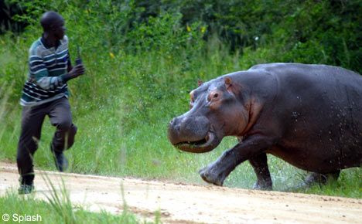
Data analysis trumps intuition!
No Hippo!
(highest paid person’s opinion)
But care is needed in designing A/B tests before generating lots of experiment data
How much user traffic should be exposed to the experiment?
How can we gather feedback on multiple changes efficiently? (multivariable testing)
What is the effect of robots? They get more sophisticated with time…
Timing: Experiments at Amazon showed a 1% sales decrease for an additional 100msec delay in treatment condition
Source: http://ai.stanford.edu/~ronnyk/2009controlledExperimentsOnTheWebSurvey.pdf

Slide 18
Some limitations of A/B tests
We can know which variant is better, but not why.
Controlled experiments run for a short period: days or weeks. May miss longer-term effects.
Novelty effects: users will explore new things.
Disorientation effects: experienced users become less efficient: the control (existing) UI has an advantage. (Maybe run for only new users).
Features must actually be implemented. Significant engineering investment in running an experiment.
Source: http://ai.stanford.edu/~ronnyk/2009controlledExperimentsOnTheWebSurvey.pdf

Slide 19
Two new sources of large volumes of data processing:
A/B testing, experimental data (web site optimization)
Crowdsourcing and human computation
Network analysis
Data fusion and integration
Genetic algorithms
Machine learning
Natural language processing
Signal processing
Simulation
Time series analysis
Visualization

Slide 20
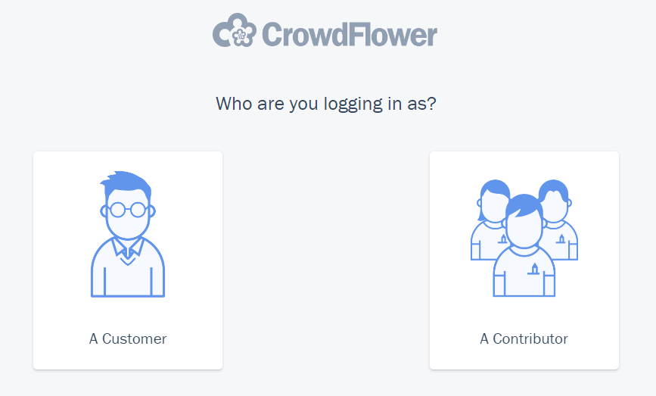
Crowdsourcing platforms: one widely used source of human computation
An online, distributed problem solving and data manipulation model
An online marketplace platform that brings together
Customers with tasks they need done
Contributors (workers) who can do the tasks
Example tasks:
Annotate an image with text descriptions / tags
Judge if a Web page is relevant to a query
Give feedback/ratings on a product design

Slide 21
Human Judgment At Scale
Use crowdsourcing as a scientific tool
Behavioral Experiments [Paolacci, Chandler, & Ipeirotis, 2010; Mason and Suri, 2012]
Image Annotation [Sorokin, Forsyth, 2008; Deng et al., 2009]
NLP [Alonso and Mizzaro, 2009]
Search [Kim, Collins-Thompson and Teevan, 2013]
Social [Burgess, Mazzia, Adar, Cafarella, 2013]
Advantages: supply availability [Ipeirotis, 2010], comparable performance to in-lab subjects [Paolacci, Chandler, & Ipeirotis, 2010], ease of use [Göritz, Wolff, and Goldstein (2008)] …

Slide 22
Human computation for natural language text processing
Enough crowd workers can often match experts
Tasks:
Word similarity
Affect/sentiment recognition
Textual entailment (A implies B is most likely true)
Event temporal ordering
Reading difficulty
Peer evaluation in large online courses
High agreement between workers, gold standard
Example: R. Snow, B. O’Connor, D. Jurafsky, and A. Y. Ng. “Cheap and Fast But is it Good? Evaluating Non-Expert Annotations for Natural Language Tasks”. EMNLP-2008.

Slide 23
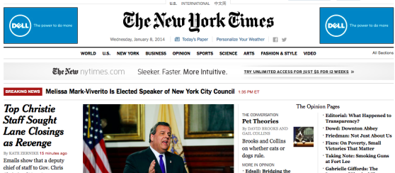
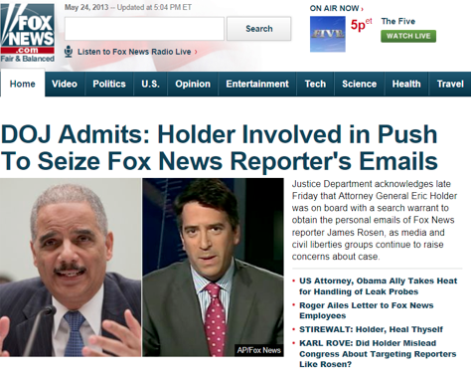
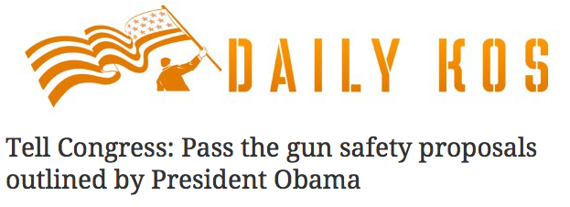

Example 1 crowdsourcing task: estimating news media bias [Budak et al. Public Opinion Quarterly 2016]
Goal: Understand and quantify U.S. news media bias
Prevalence…
What fraction of content is biased?
Is media slant only seen in op-eds, or does it creep into descriptive news?
Form…
Selective coverage?
Issue-specific slant?
Approach: Investigate selection and framing of political issues in 15 major online U.S. news outlets through a combination of machine learning and crowdsourcing techniques

Slide 24
Example 1 crowdsourcing task: estimating news media bias
➔ possible values between [-1,1]

Slide 25
Example 2 crowdsourcing task: estimating inefficiencies in the charitable giving marketplace [Budak et al.. ICWSM 2016]
How efficient/inefficient is the current (200 Billion dollars/year)charity marketplace? How many more dollars would be used directly on charitable causes if donors were to opt for better run organizations with lower overhead?
Need to first understand which charities are good substitutes for each other. We rely on human judgment

Slide 26
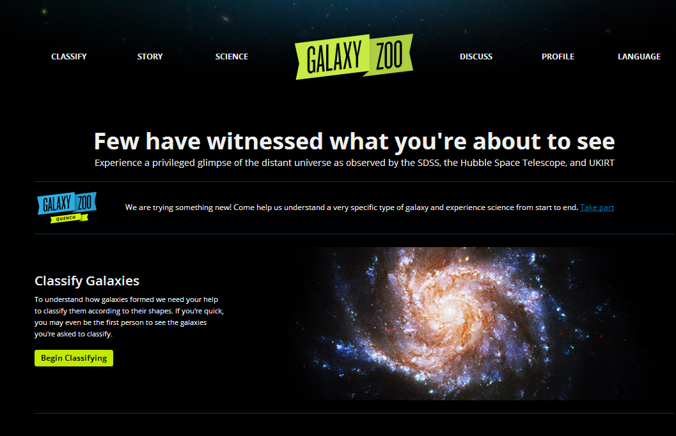
Example 3 task: Human classification, recognizing and clustering galaxies
Source: http://www.galaxyzoo.org/

Slide 27
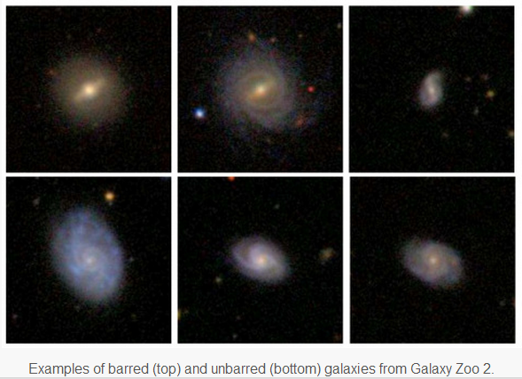
How likely is a certain type of disk galaxy to have a bar as a function of other properties?

Slide 28
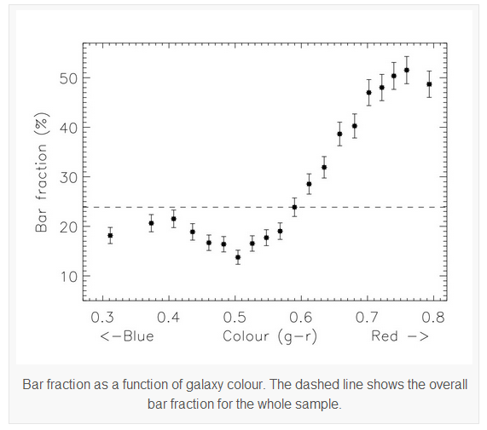
Observed: strong correlation in galaxy color vs bar fraction Redder disk galaxies are much more likely to have bars identified by GZ2 users than bluer disk galaxies.
All of this is based on human data mining

Slide 29
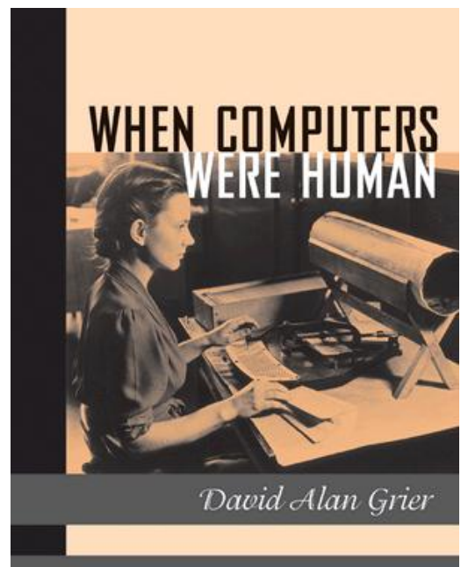
Not quite a new idea

Slide 30
What are some challenges in using human computation for data manipulation and analytics?
Modeling and correcting for unreliable raters
Maximizing information gain for cost/budget
Speed: typically slow, plus time vs quality tradeoffs
Finding qualified raters for your task
May require extended training period or paying retainer
Expert crowds, higher cost
Lack of diversity in crowd
Running randomized experiments
Privacy and security
Ethics: low-cost labor

Slide 31
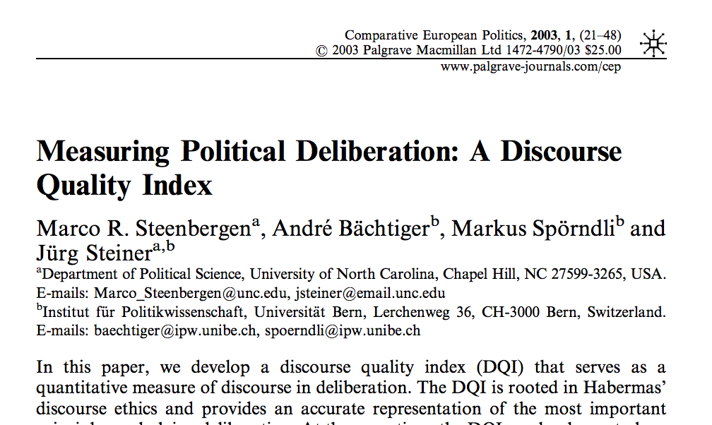
Creating a Simple Mturk Task
Let’s say we want to understand how deliberative comments in news forums are…

Slide 32
Code books from communication theory
Level of Justification: indicate if the writer gives any reasons (arguments or evidence) for his/her opinion, and if they make a connection between those reasons and his/her opinion.
(0) No justification: A writer only expresses an opinion, but no reasons for that opinion are given.
(1) Inferior justification: The writer gives a reason (or reasons) to support their opinion, but no connection is made between the opinion and reason…
(2) Qualified justification: The writer gives a reason (or reasons) to support their opinion and makes a connection for how that reason supports their opinion. …
Content of justifications: decide if the reason given (if, indeed, any were given) was one that appeals either to narrow group interests or to the common good - or to both.
No reasons were given or the reasons did not reference either specific group interests, the common good or common values.
Reasons related to specific group interests: The reasons given were in terms of benefiting a particular group or aligning with the values of a particular group.
Reasons related to common good or common values: At least one of the reasons given is framed in terms of helping the common good (that is, everyone will benefit) or being in line with common values.
Constructive politics: this dimension concerns consensus building, or “constructive politics.” We capture this via two codes:
Positional: Writer is emphatic about their opinion. There is no attempt at compromise, reconciliation, or consensus building.
Constructive: The writer attempts to promote solutions or propositions that might be compromises or move toward agreement.

Slide 33
How to collect labels through Amazon Mechanical Turk

Slide 34
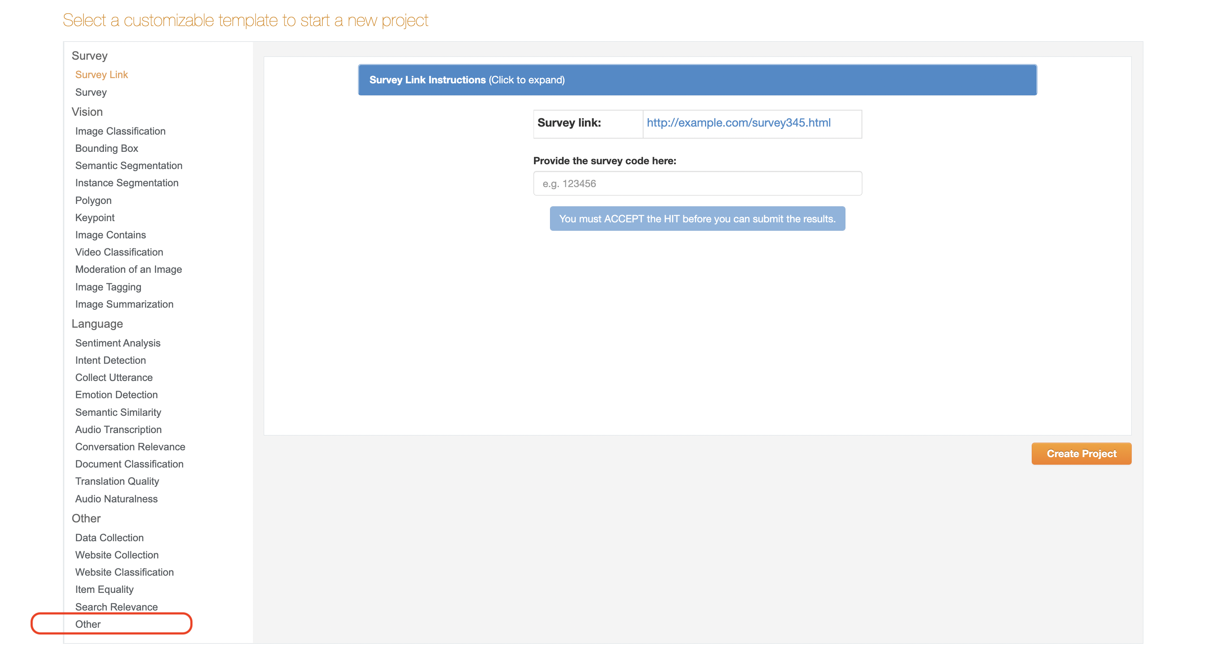
Choosing a Project Type

Slide 35
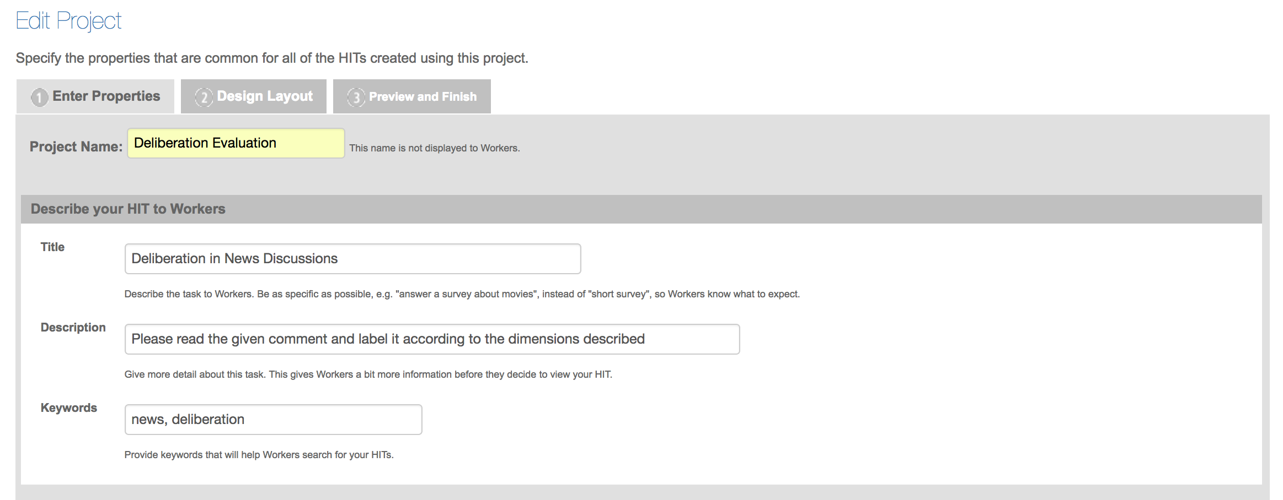
Creating your project

Slide 36
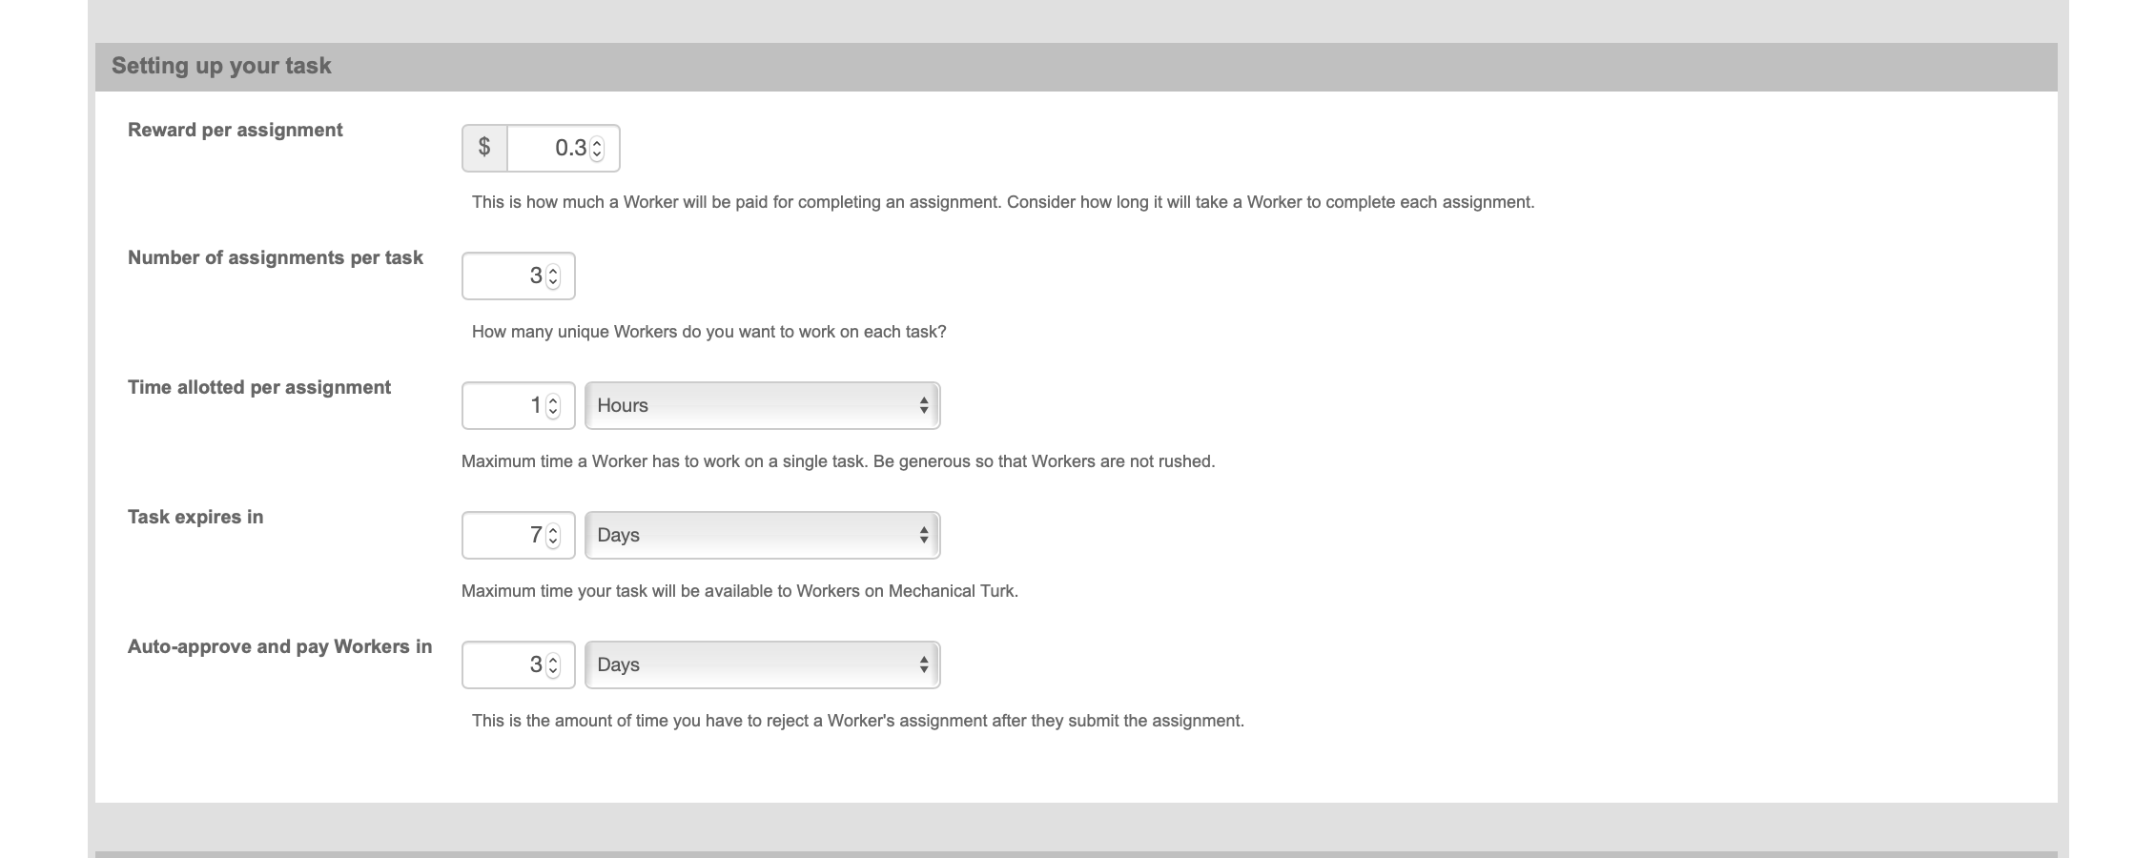
Creating your project

Slide 37
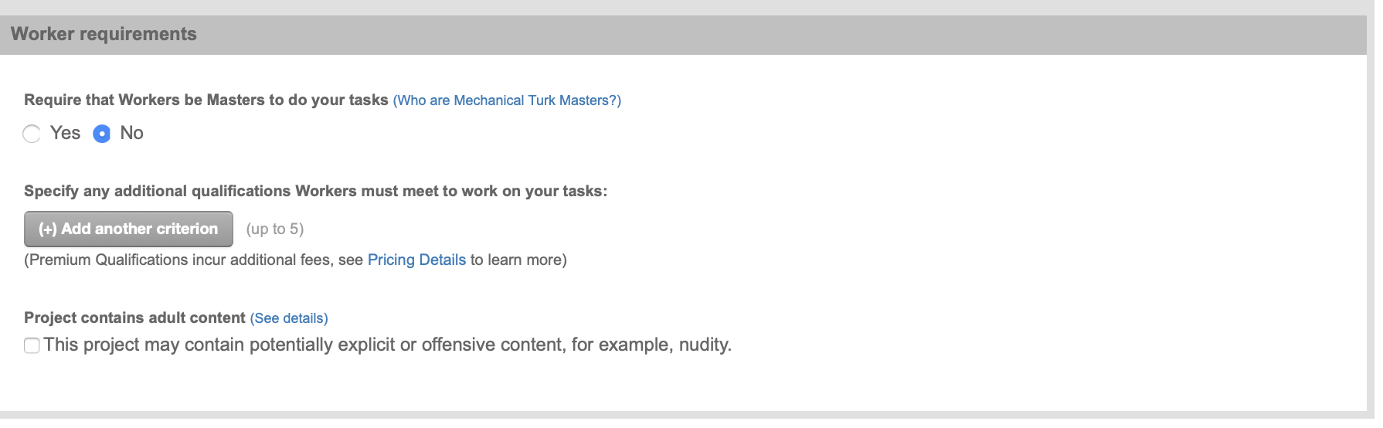
Creating your project

Slide 38
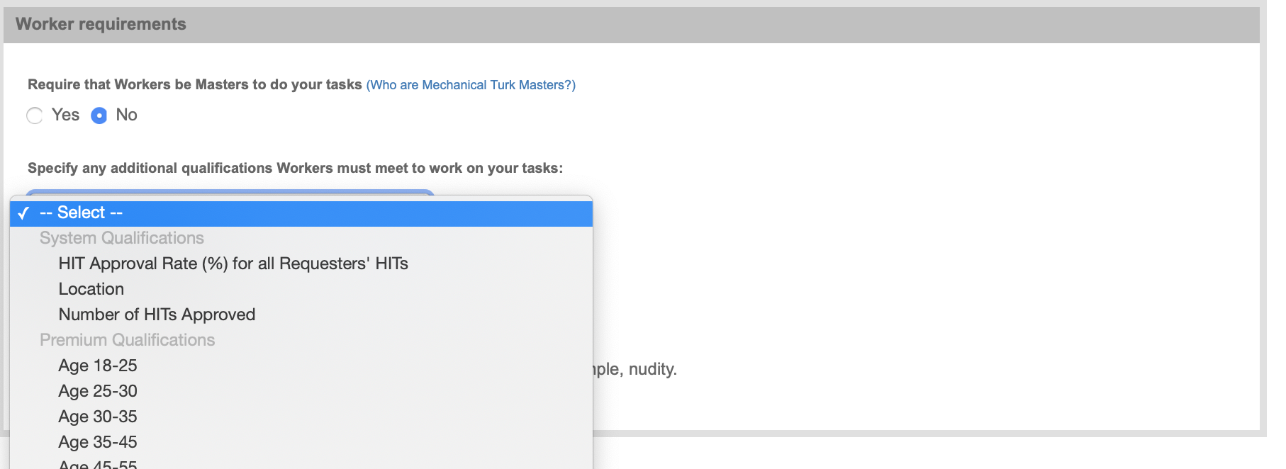
Creating your project

Slide 39
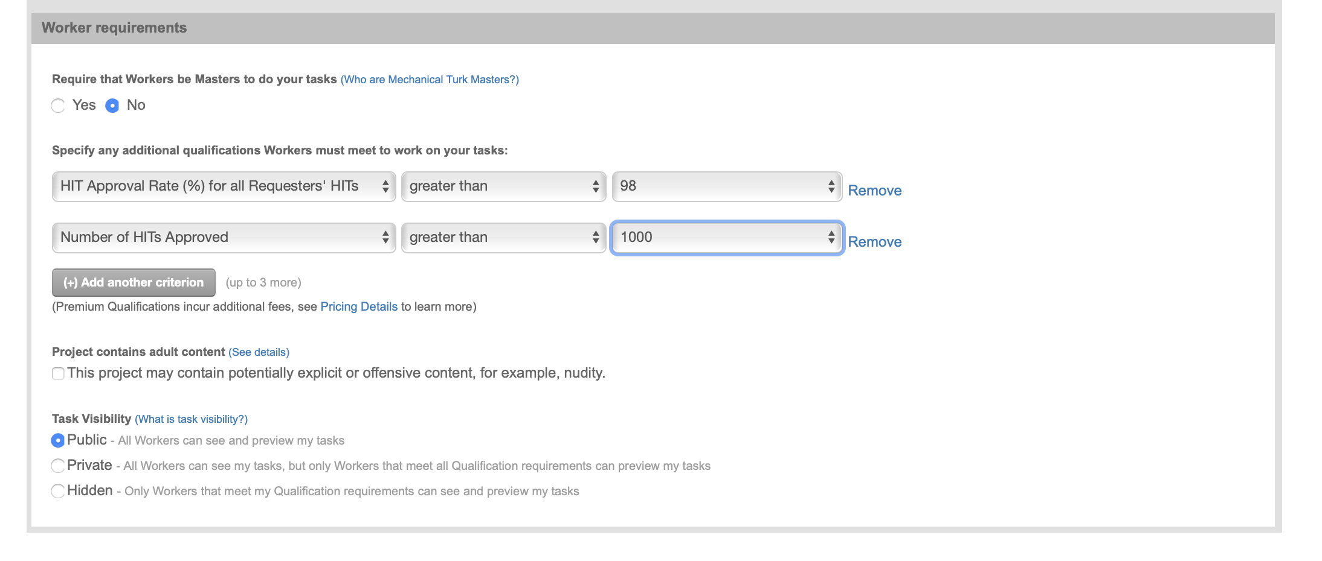
Creating your project

Slide 40
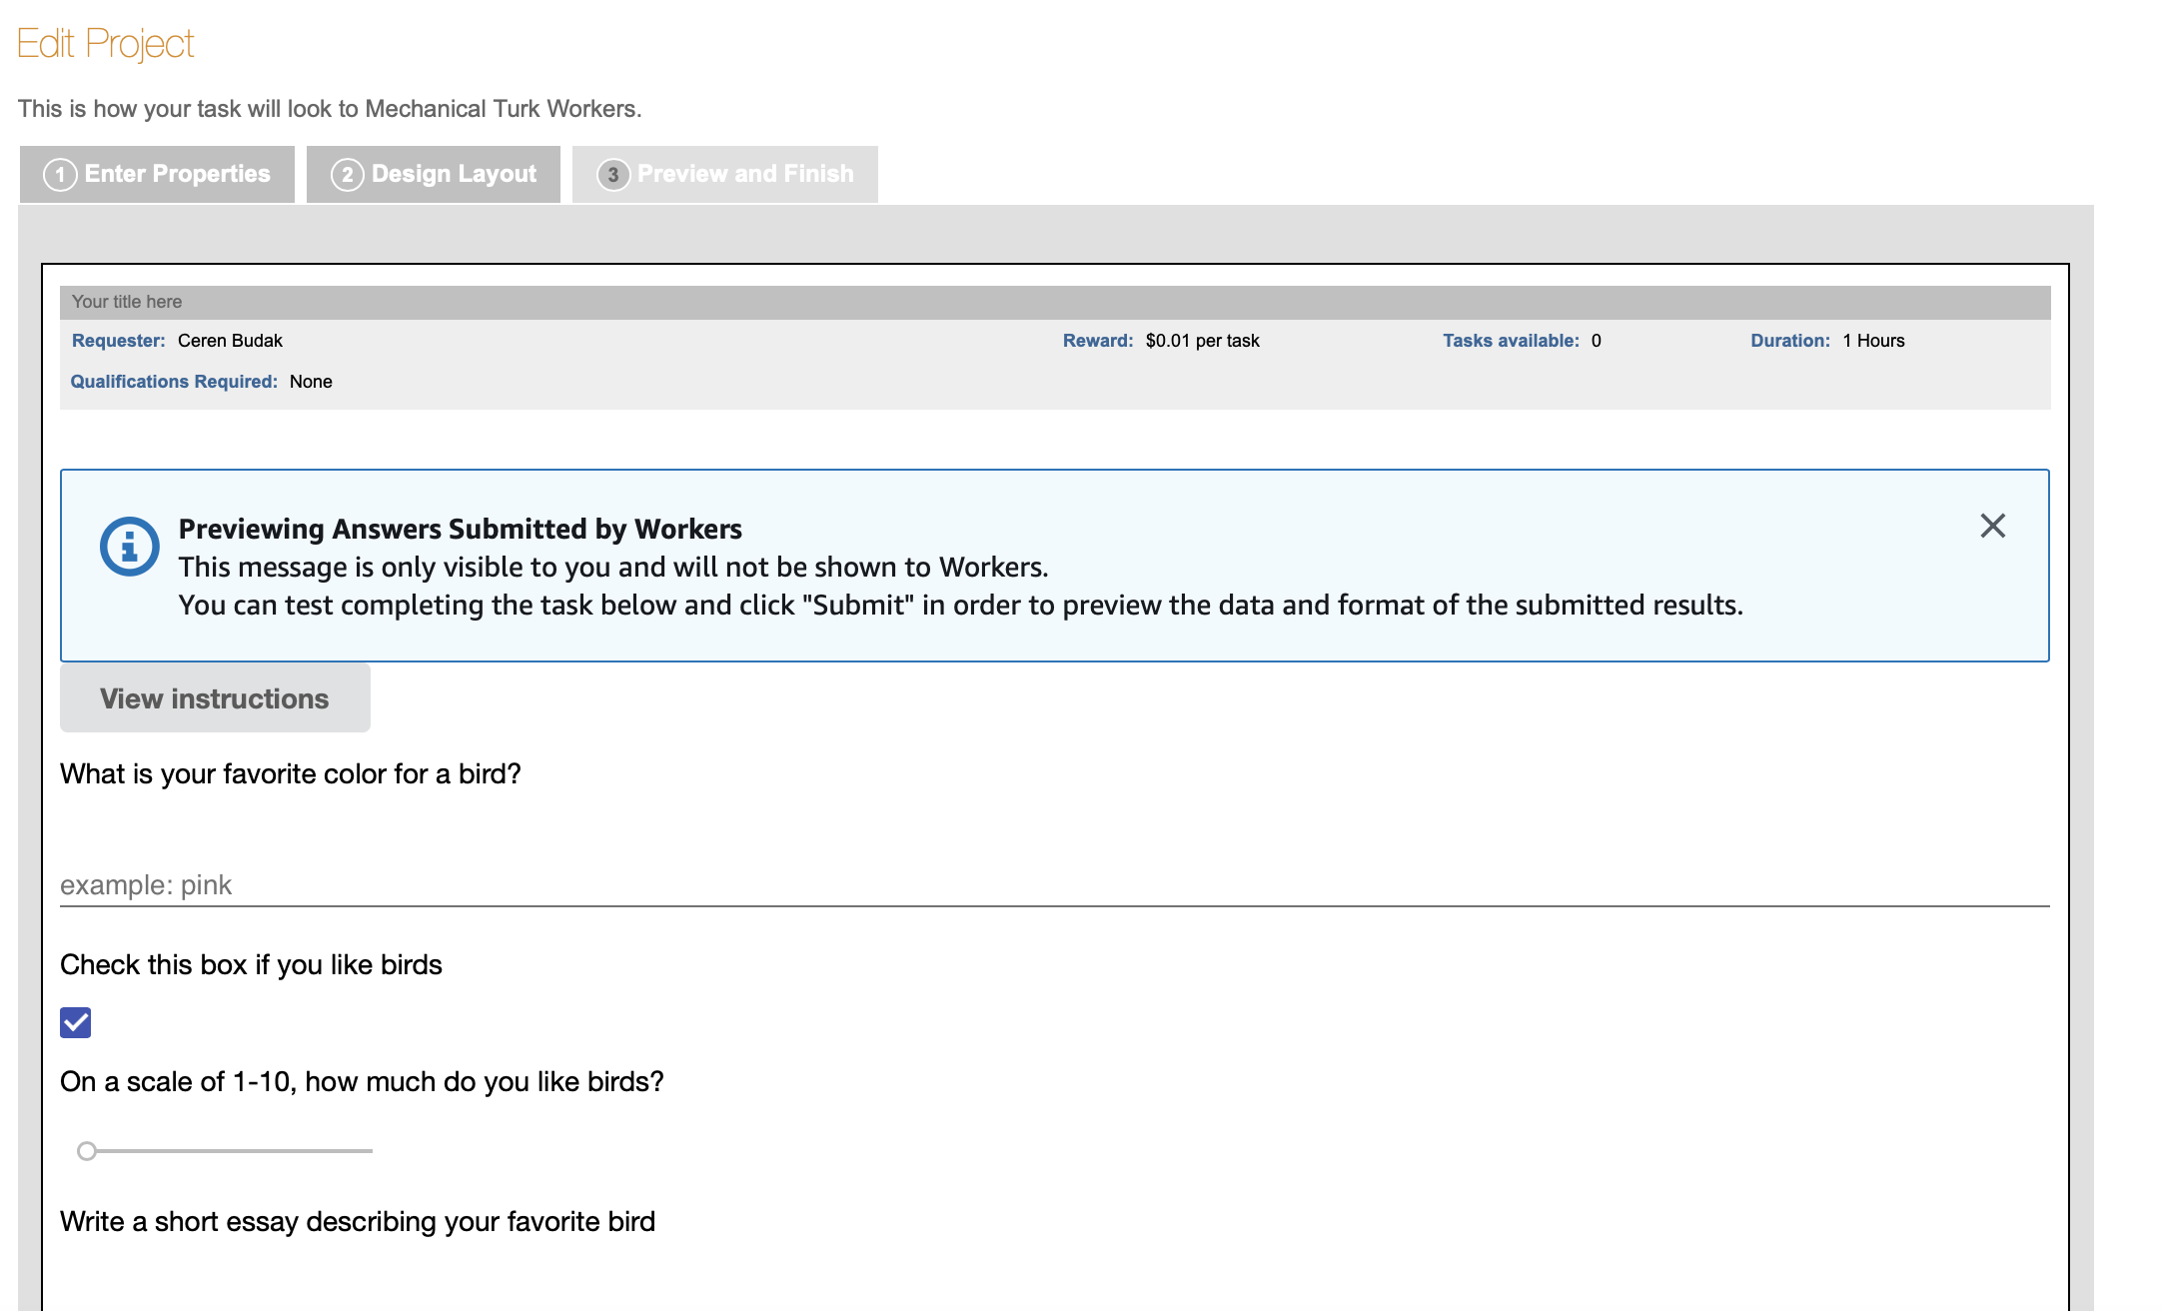
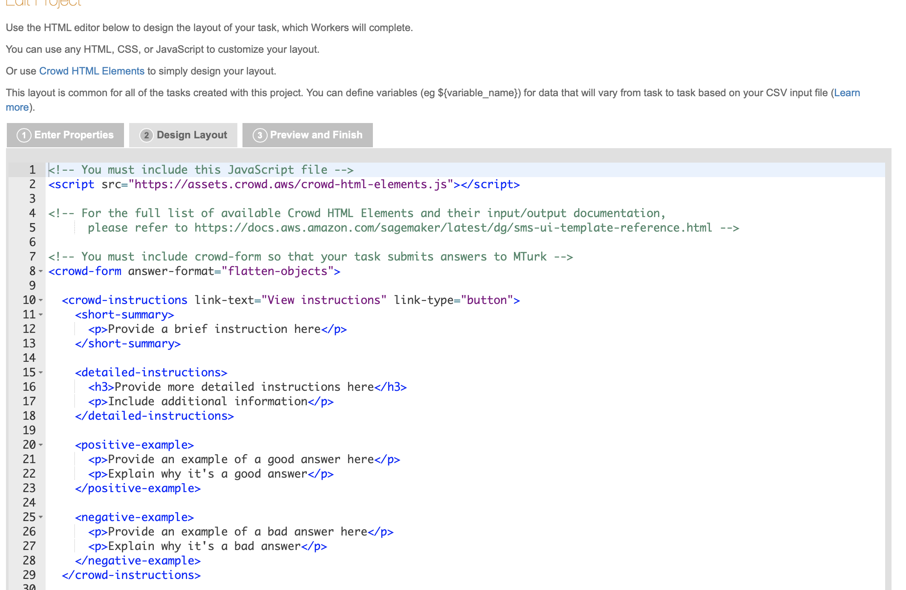
Creating your project - Design
A template is generated for you automatically that you can change to fit your own project.
Toggle between preview/finish and design layout to make changes and see its results

Slide 41
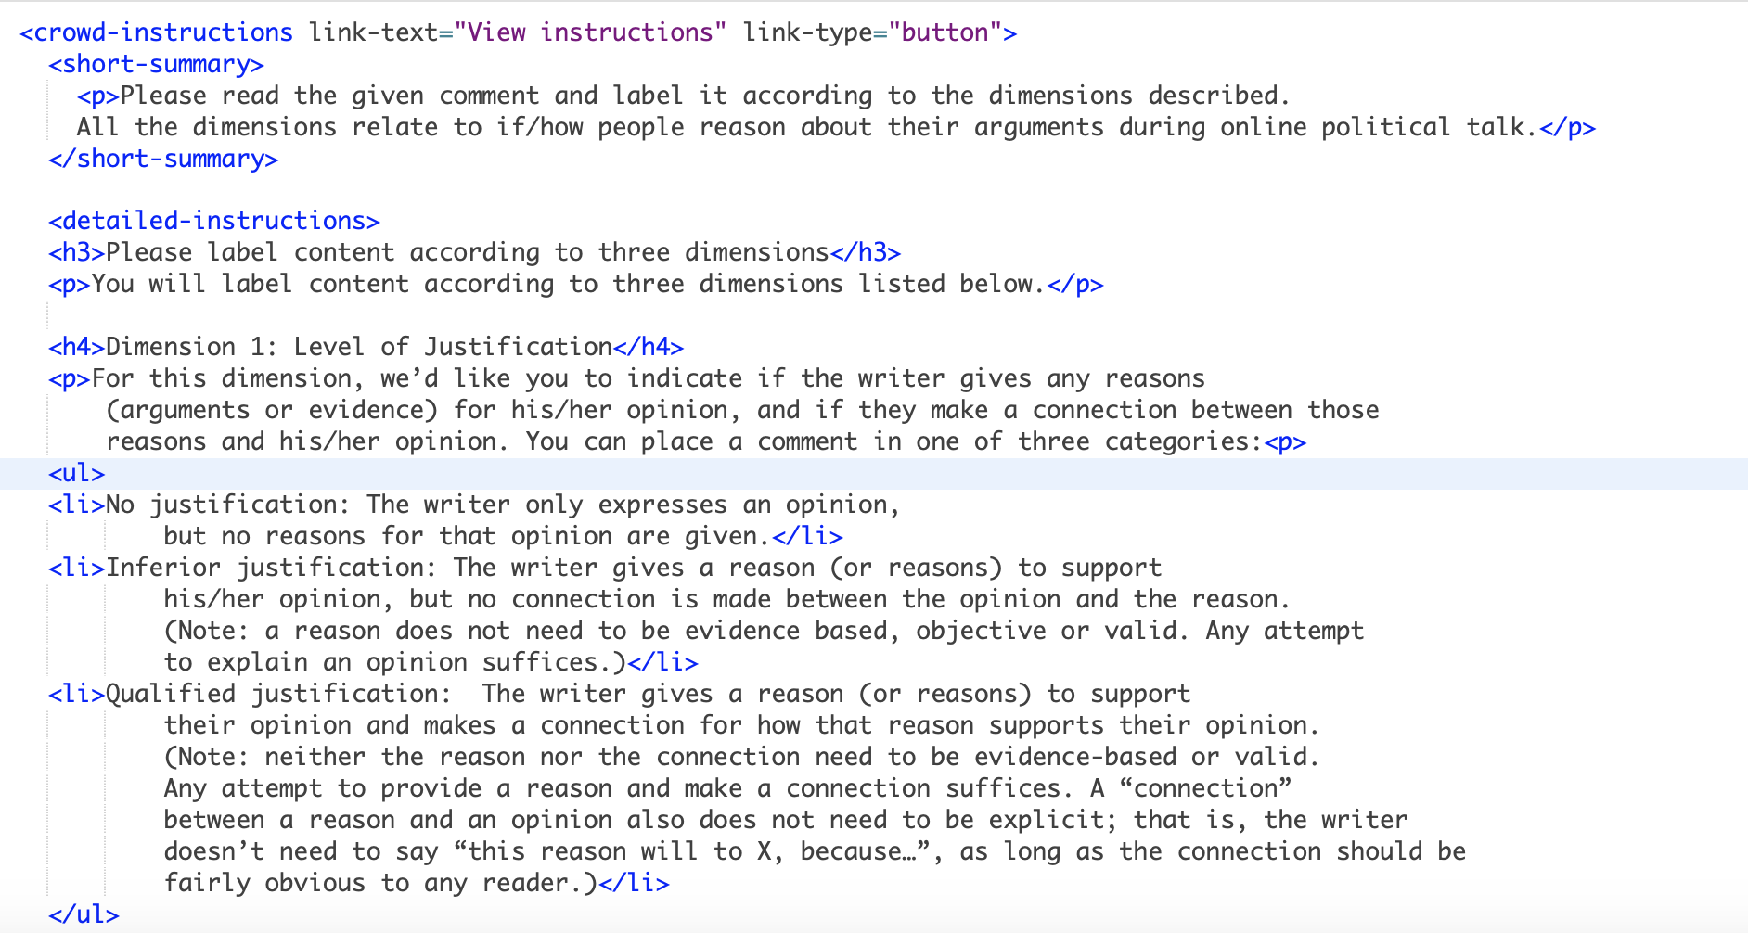
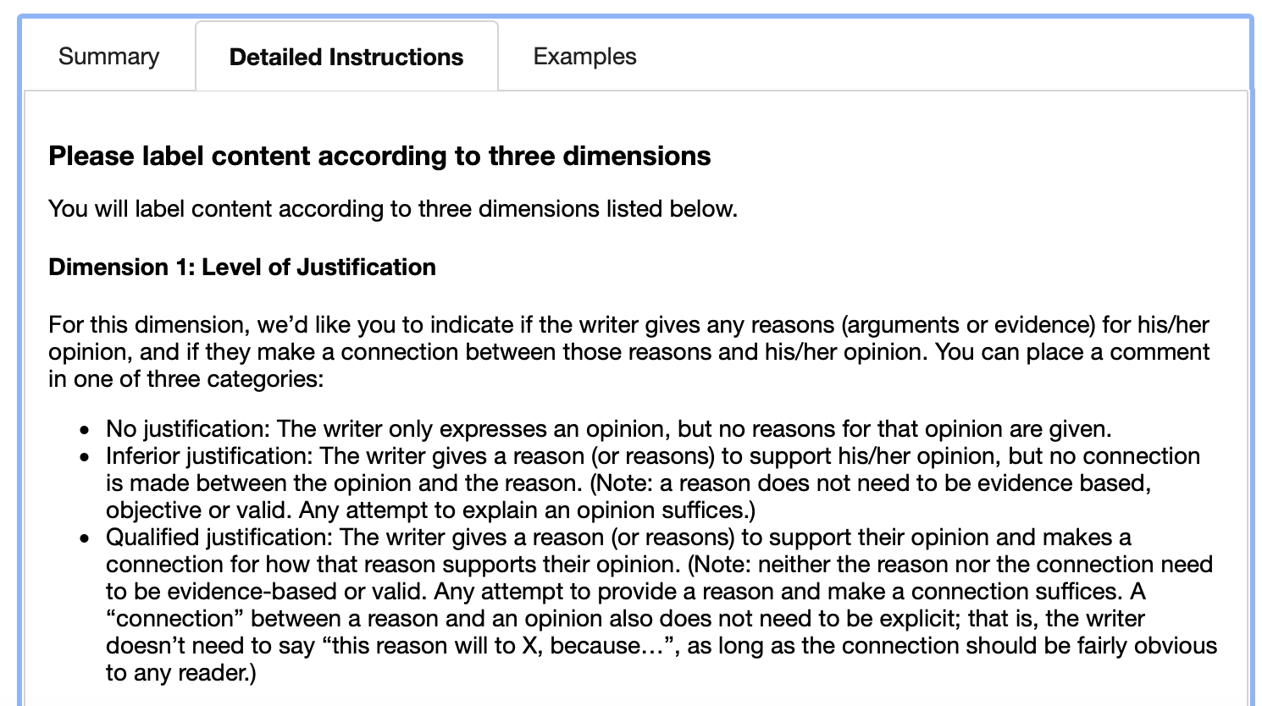
Making the Appropriate changes
Change the instructions

Slide 42
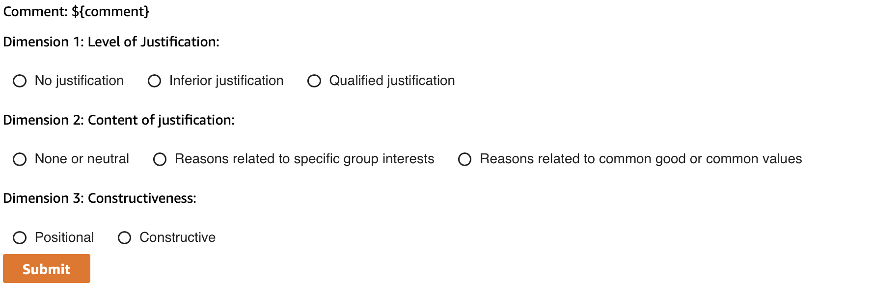
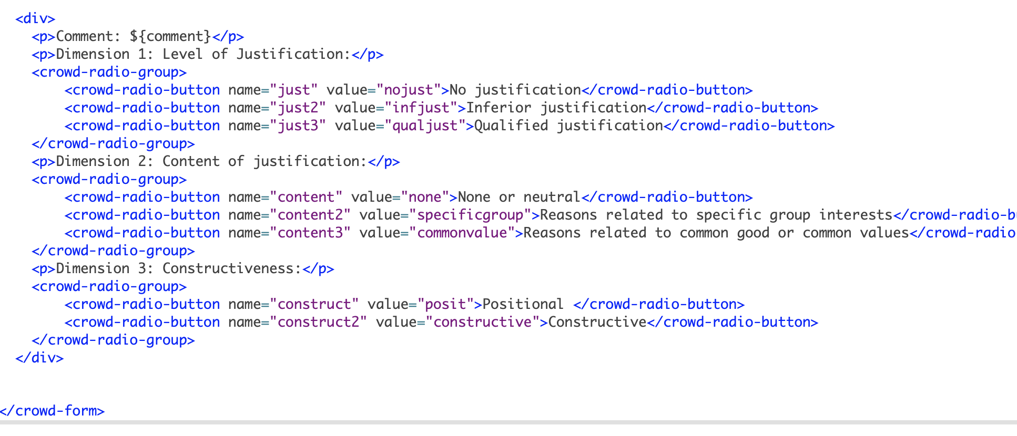
Making the Appropriate changes
Change the questions

Slide 43
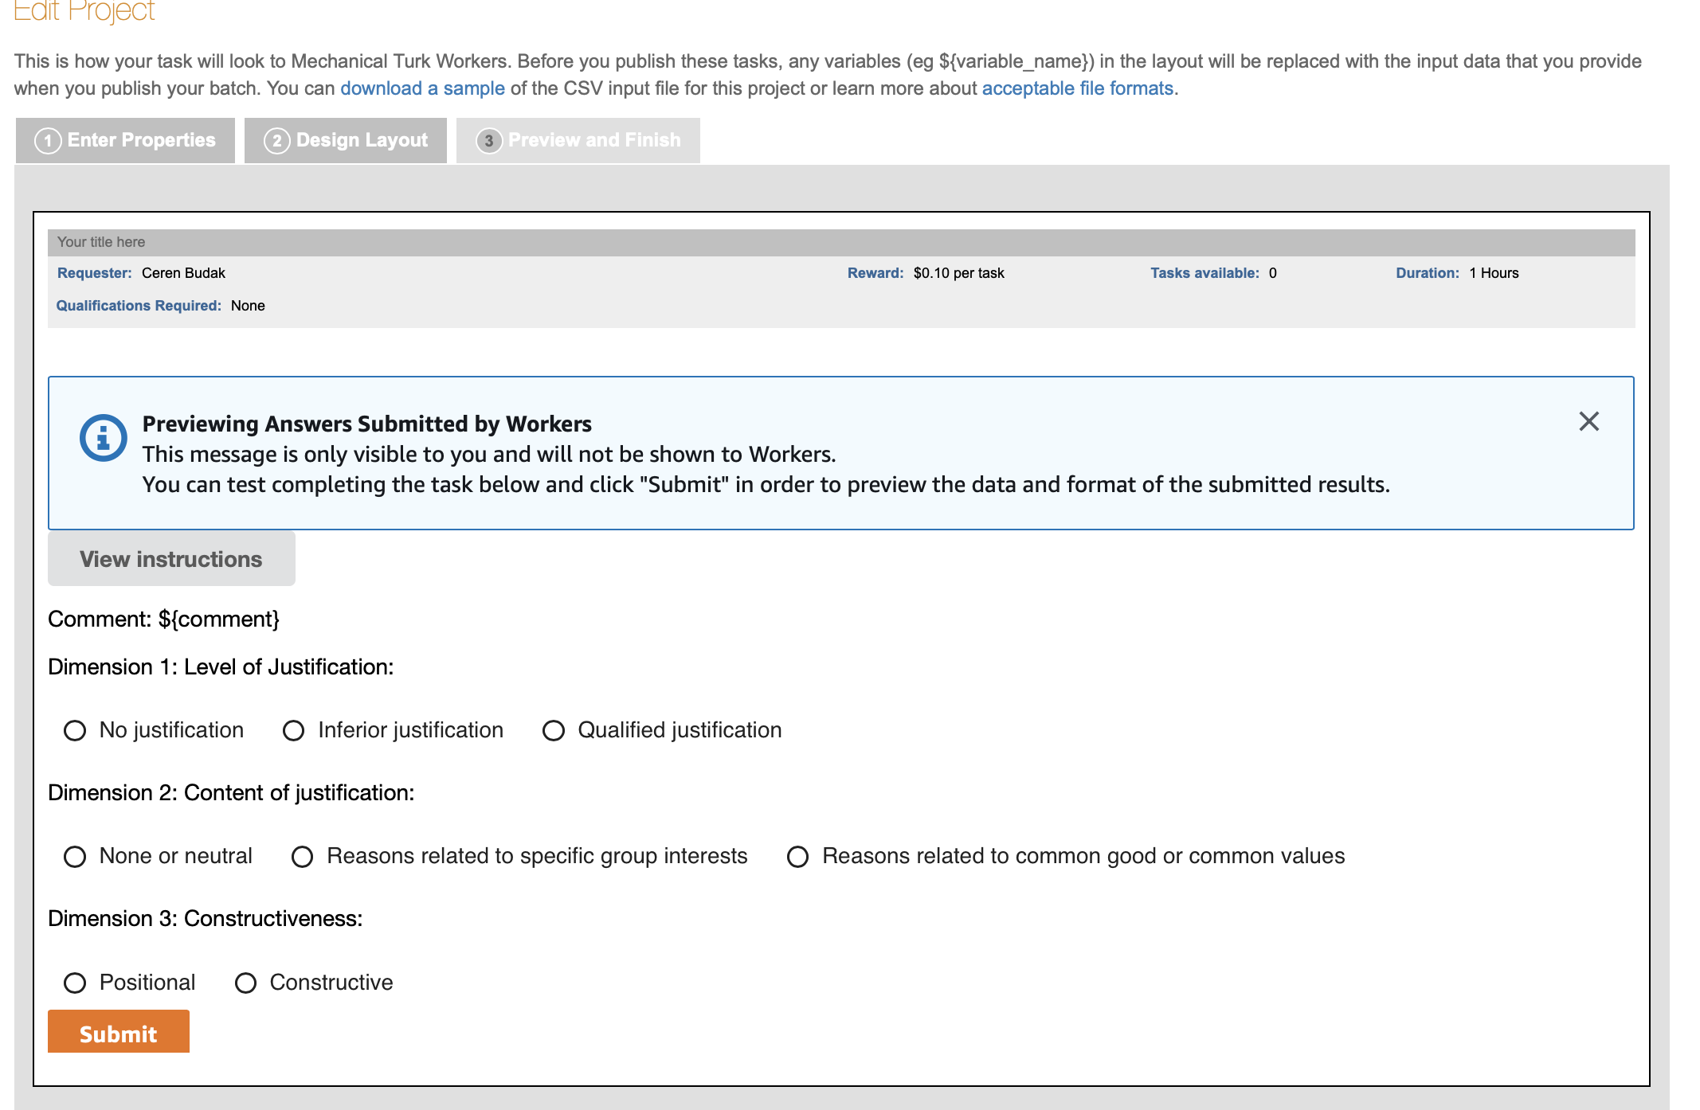
After you make your changes

Slide 44
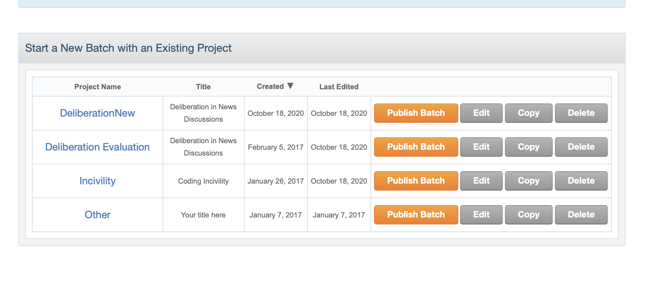
Publishing Batches/Input format
Once you are done with creating your project, you can publish a batch

Slide 45
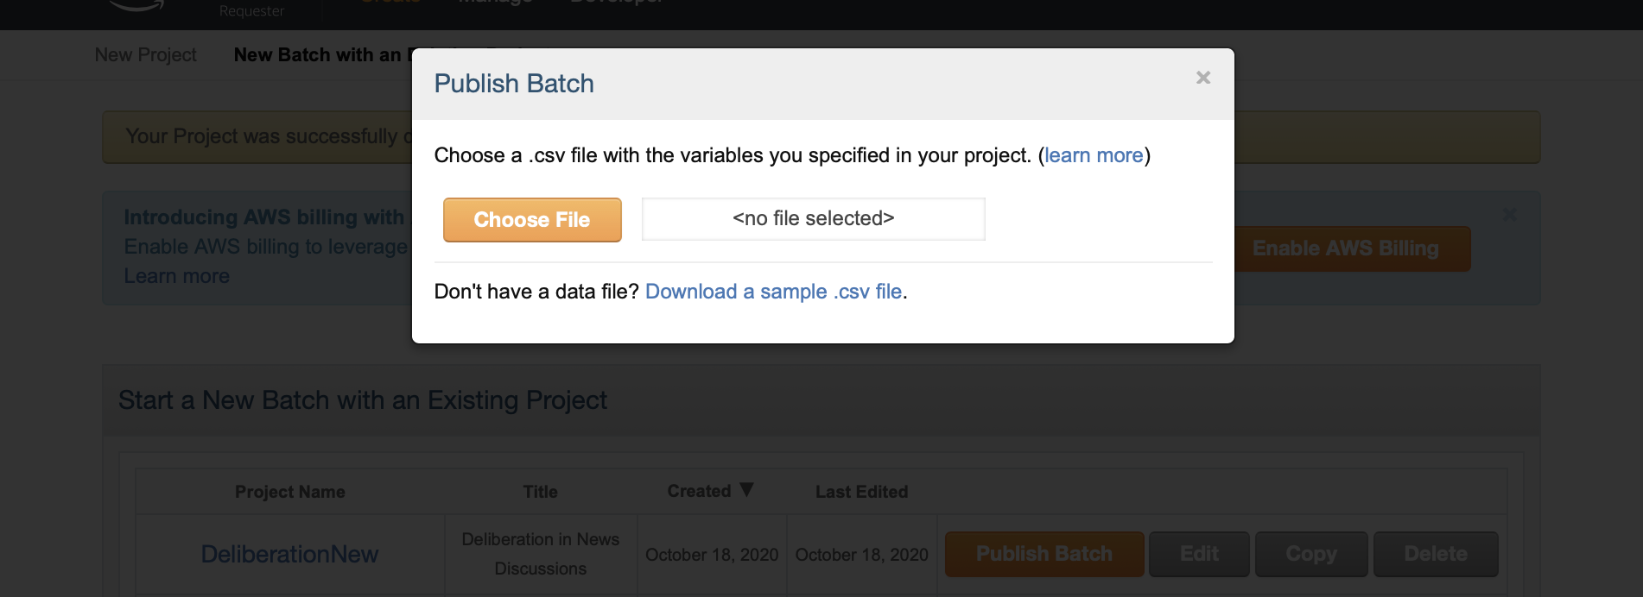
Publishing Batches/Input format
Once you are done with creating your project, you can publish a batch
You can see that the format of the file you need to create

Slide 46
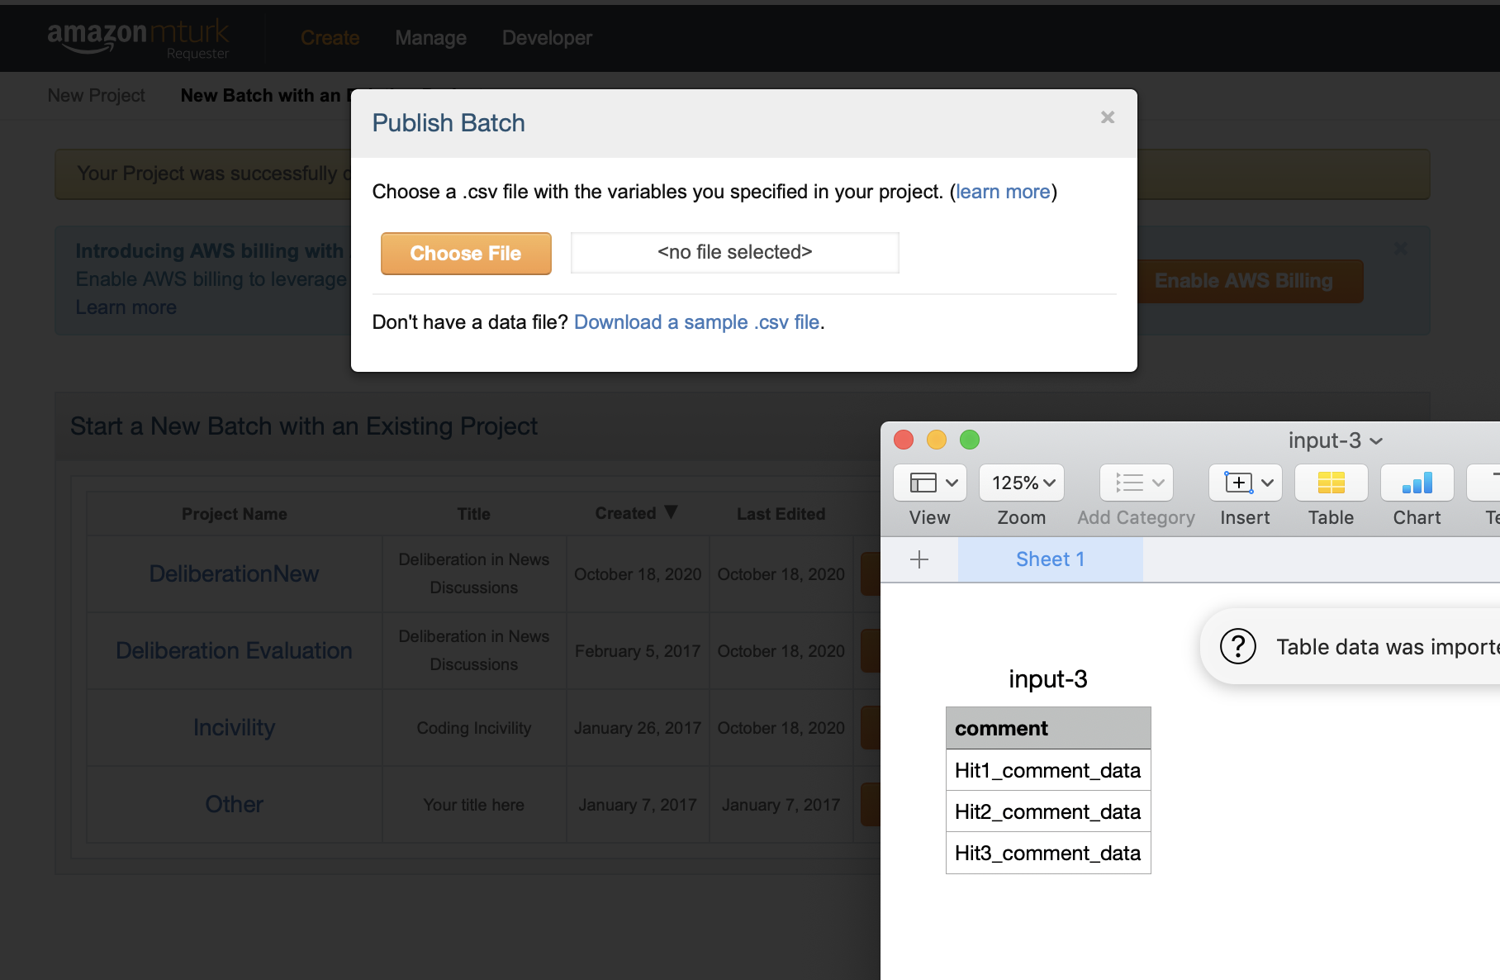
Publishing Batches/Input format
Once you are done with creating your project, you can publish a batch
You can see that the format of the file you need to create

Slide 47
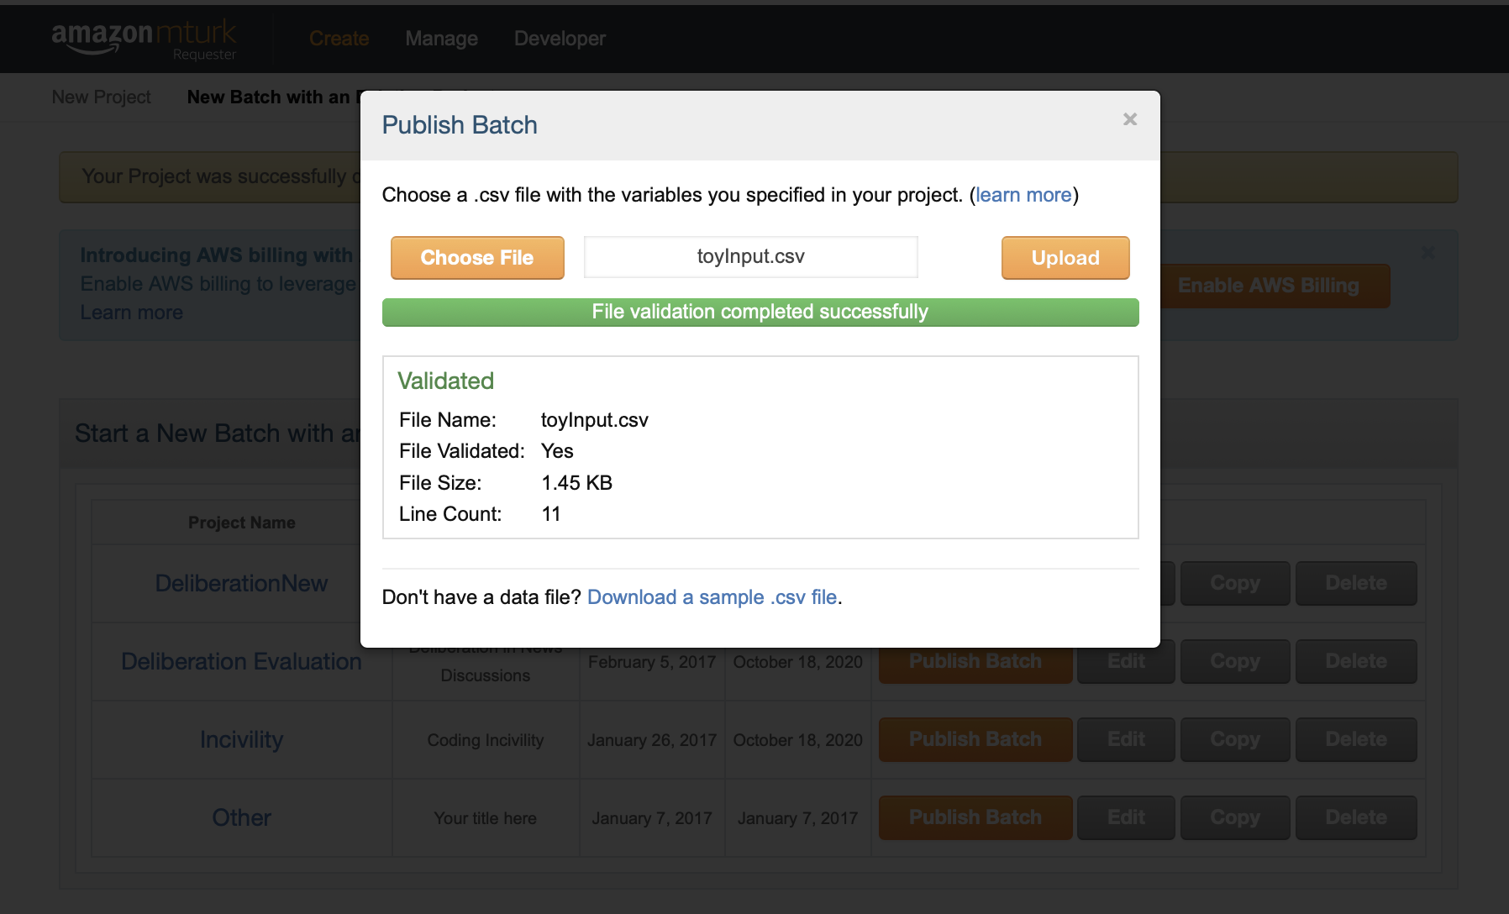
Publishing your HITs

Slide 48
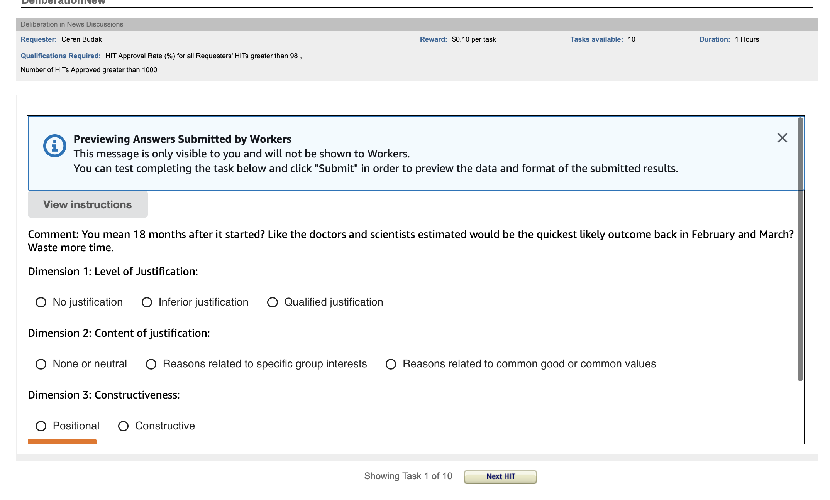
Publishing your HITs

Slide 49
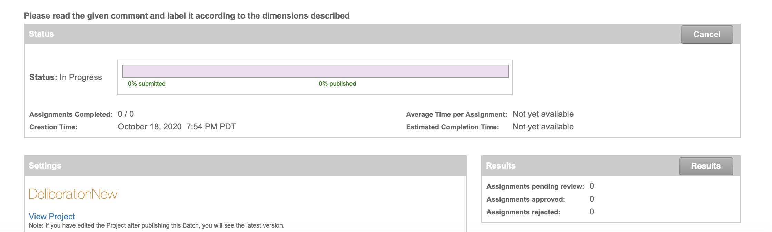
Inspecting the Results

Slide 50
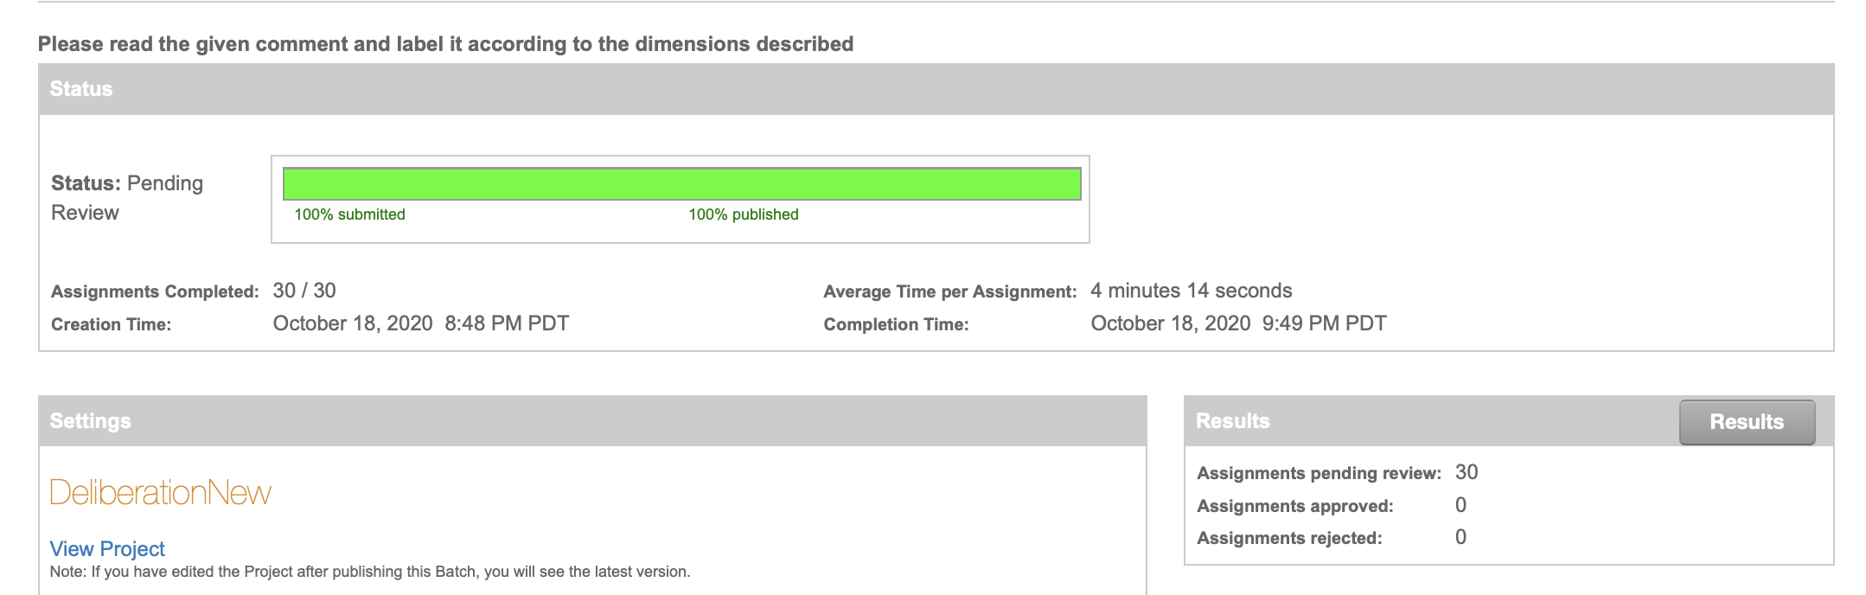
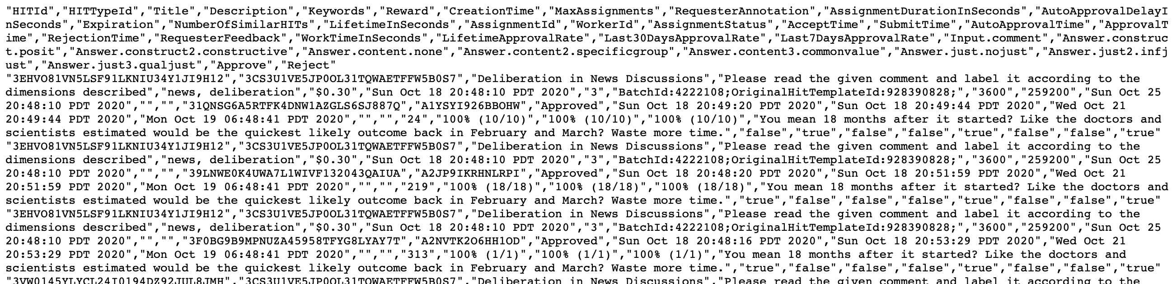
Inspecting the Results

Slide 51
Ethical Considerations of Crowdsourcing
What are some potential ethical concerns about crowdsourcing?
Most work focuses on work on the ethics of crowdsourcing focused on labor conditions, such as fair pay, and on privacy issues (Fort et al., 2011; Gray and Suri, 2019).
Texts can potentially harm readers. Consider, for instance, the psychological cost of work done by commercial content moderators (Steiger et al., 2021)
Potential for breaching anonymity and privacy (Lease et al., 2013)
Important to prioritize Respect for Persons, Beneficence, and Justice (ethical principles outlined by the Belmont Report) (Shmueli et al., 2021)

Slide 52
Projects
Data Gathering and Processing Project Proposals are due October 6.
Think of a topic you are passionate about and for which you can use data (choose at least two different large-scale datasets) to address important questions
Say you are passionate about understanding racial justice. You can find relevant data in various sources (e.g., openpolicing.stanford.edu/data) and combine with other datasets, e.g., social media
Or say that topic is food. You can find relevant data there too. (e.g., foodnetwork.com, flavornet.com)
And so much more… Check out example projects from the previous years.
The point is to find your calling, find your questions, and ask questions if you are stuck
You can see that I am asking you to use at least two datasets? Why?
Make sure you use large-scale computation techniques (mrjob or spark, which we will earn about next week)

Slide 53
Projects
Keep in mind the UMSI mission/goals:
Learning and research that deeply engage pressing social issues
Public and scholarly impact
Effective stewardship of public and donor resources
Pursuit, integration, and respect of diverse intellectual perspectives
Being intellectually adventurous and creative
Public access to information
Civility and respect in public discourse
Public undergraduate and graduate education as a path for increased social and economic mobility, in particular for student populations historically underrepresented in higher education
Passion and engagement
Work-life balance
Diversity, equity, and inclusion

Slide 54
Crowdsourcing and Human Computation: People as data manipulators and analyzers
Use humans as processors in a distributed system
Humans do tasks computers cannot (do well)
System makes opaque “external call” to the “HPU”
HPU has describable functional capabilities [J. Davis et al., ACVHL’10]
Ex. 1: Detect CPU (Captcha – “reverse Turing test”)
Ex. 2: HPU computation (e.g. labeled data)
linear, with minimal post-processing of HPU output
e.g. ReCaptcha, ESP game, most Mechanical Turk work
Ex. 3: Integrate CPU + HPU computation
HPU part of core system architecture, many invocations
Source: http://ir.ischool.utexas.edu/wsdm2011_tutorial.pdf

Slide 55
Human-in-the-loop data manipulation and analysis
CPU + HPU hybrid applications blend automation with human computation to achieve new capabilities exceeding components
– CrowdSearch [T. Yan et al., MobiSys 2010]
Real-time accurate image search on mobile phones
– Soylent: A Word Processor with a Crowd Inside. [M. Bernstein et al. UIST 2010.]
– Translation by Interactive Collaboration between Monolingual Users, [B. Bederson et al. GI 2010]
– Slow Search
[J. Teevan, K. Collins-Thompson, R. White, S. Dumais, CACM Aug 2014.]

Slide 56
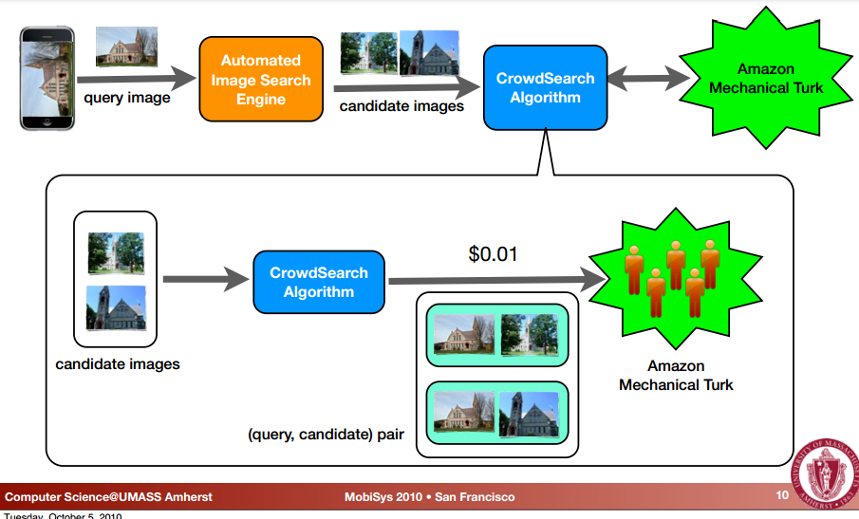
CrowdSearch: adding human verification to image search
Source: http://www.csce.uark.edu/~tingxiny/pubs/MobiSys10-final.pdf

Slide 57
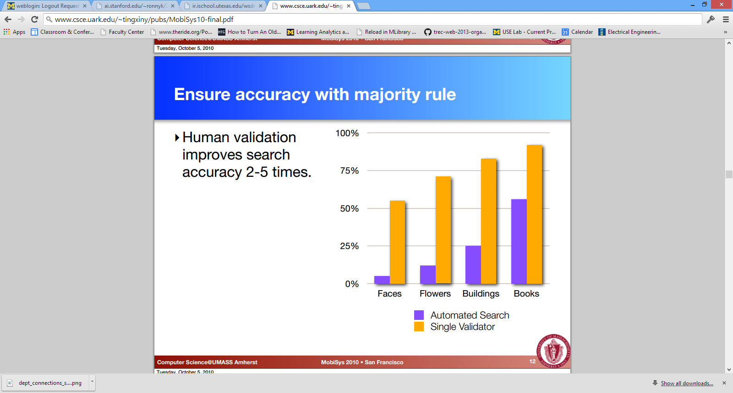
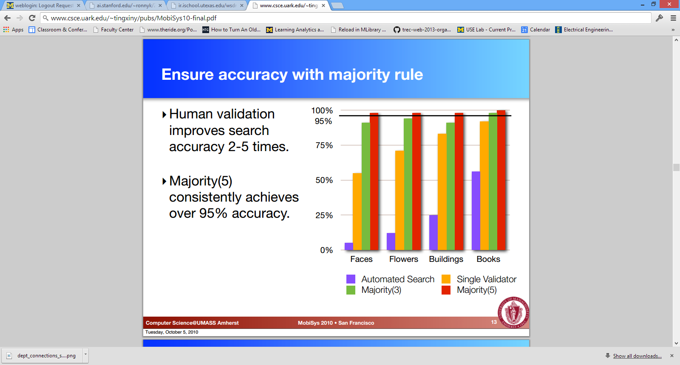
Even a small amount of extra human computation can make a large improvement in accuracy
Source: http://www.csce.uark.edu/~tingxiny/pubs/MobiSys10-final.pdf

Slide 58
References
Karën Fort, Gilles Adda, and K Bretonnel Cohen. 2011. Amazon mechanical turk: Gold mine or coal mine? Computational Linguistics, 37(2):413–420.
Mary L. Gray and Siddharth Suri. 2019. Ghost Work: How to Stop Silicon Valley from Building a New Global Underclass. Houghton Mifflin Harcourt, Boston, MA.
Matthew Lease, Jessica Hullman, Jeffrey Bigham, Michael Bernstein, Juho Kim, Walter Lasecki, Saeideh Bakhshi, Tanushree Mitra, and Robert Miller. 2013. Mechanical Turk is not anonymous. Available at SSRN 2228728.
Boaz Shmueli, Jan Fell, Soumya Ray, and Lun-Wei Ku. "Beyond fair pay: Ethical implications of NLP crowdsourcing." arXiv preprint arXiv:2104.10097 (2021).
Miriah Steiger, Timir J Bharucha, Sukrit Venkatagiri, Martin J Riedl, and Matthew Lease. 2021. The psychological well-being of content moderators. In Proceedings of the 2021 CHI Conference on Human Factors in Computing Systems, CHI ’21, New York, NY, USA. Association for Computing Machinery.

